Slide 1
INTERNITY FOUNDATION
PRESENTATION ON B-TREE Presented by: Harshit Garg

Slide 2
Introduction..
B Tree is a specialized m-way tree that can be widely used for disk access.
A B-Tree of order m can have at most m-1 keys and m children.
One of the main reason of using B tree is its capability to store large number of keys in a single node and large key values by keeping the height of the tree relatively small.
It is most commonly used in database and file systems.
Important properties of a B-tree:
  B-tree nodes have many more than two children.
  A B-tree node may contain more than just a single element.

Slide 3
B Tree Properties
It contains the following properties.
Every node in a B-Tree contains at most m children.
Every node in a B-Tree except the root node and the leaf node contain at least m/2 children.
The root nodes must have at least 2 nodes.
All leaf nodes must be at the same level.
It is not necessary that, all the nodes contain the same number of children but, each node must have m/2 number of nodes.

Slide 4
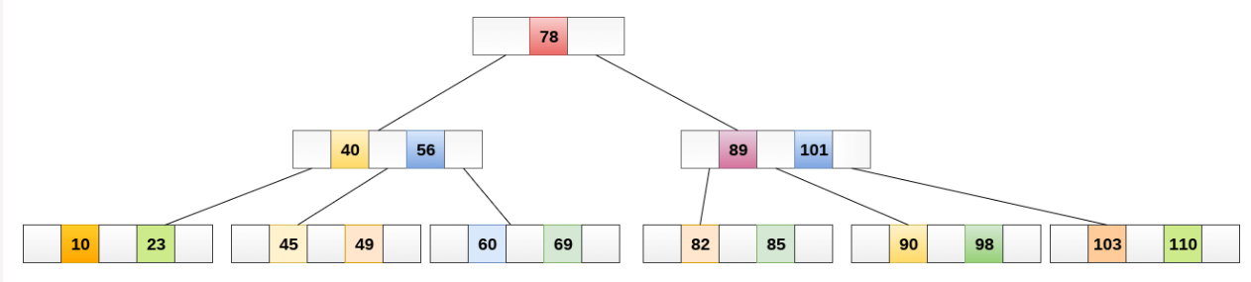
B tree of order 4
NOTE: While performing some operations on B Tree, any property of B Tree may violate such as number of minimum children a node can have. To maintain the properties of B Tree, the tree may split or join.

Slide 5
Searching in b tree..
Searching in B Trees is similar to that in Binary search tree. For example, if we search for an item 49 in the following B Tree. The process will something like following :
Compare item 49 with root node 78. since 49 < 78 hence, move to its left sub-tree.
Since, 40<49<56, traverse right sub-tree of 40.
49>45, move to right. Compare 49.
match found, return.

Slide 6
Inserting an element in a b tree..
Insertions are done at the leaf node level. The following algorithm needs to be followed in order to insert an item into B Tree.
Traverse the B Tree in order to find the appropriate leaf node at which the node can be inserted.
If the leaf node contain less than m-1 keys then insert the element in the increasing order.
Else, if the leaf node contains m-1 keys, then follow the following steps.
  Insert the new element in the increasing order of elements.
  Split the node into the two nodes at the median.
  Push the median element upto its parent node.
  If the parent node also contain m-1 number of keys, then split it too by following the same steps.

Slide 7
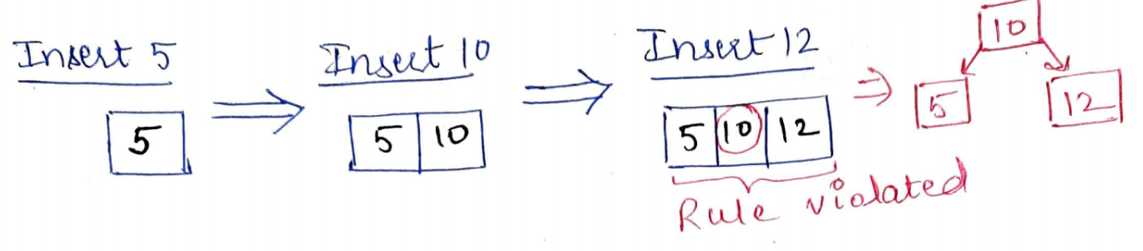
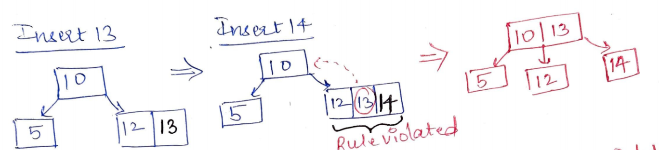
Inserting an element in a b tree..
Consider the elements 5, 10, 12, 13, 14, 1, 2, 3, 4. Insert them into empty B-Tree of order = 3.
Solution: m=3 => Maximum data = m-1=2 and max child = 3.

Slide 8
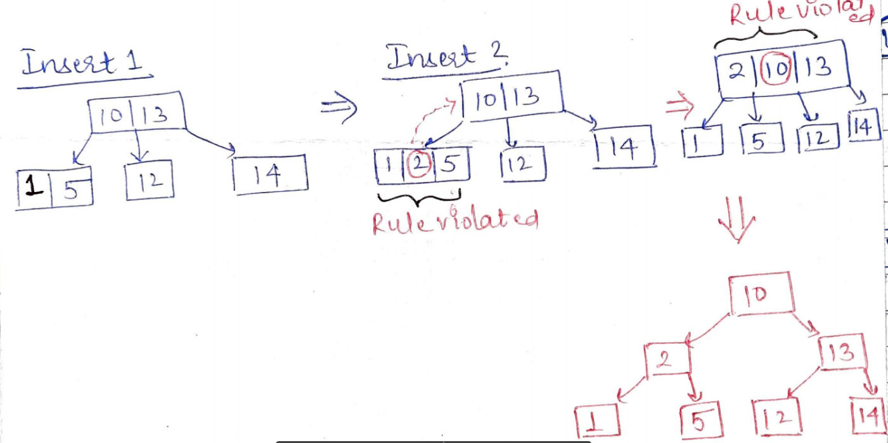
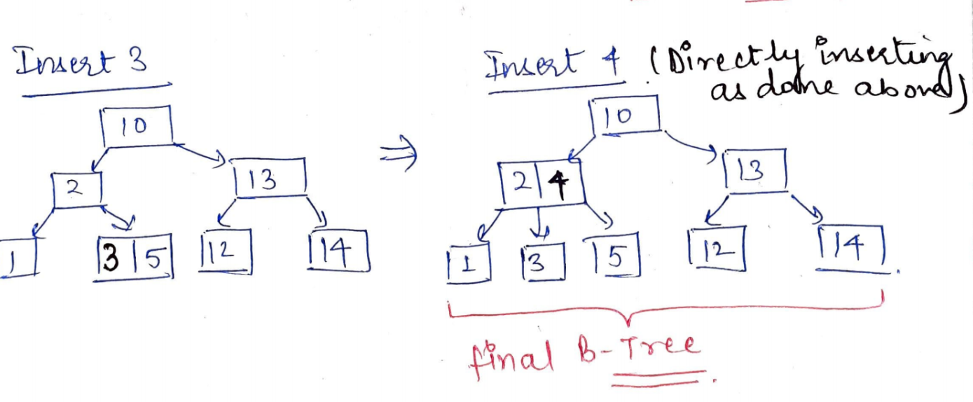

Slide 9
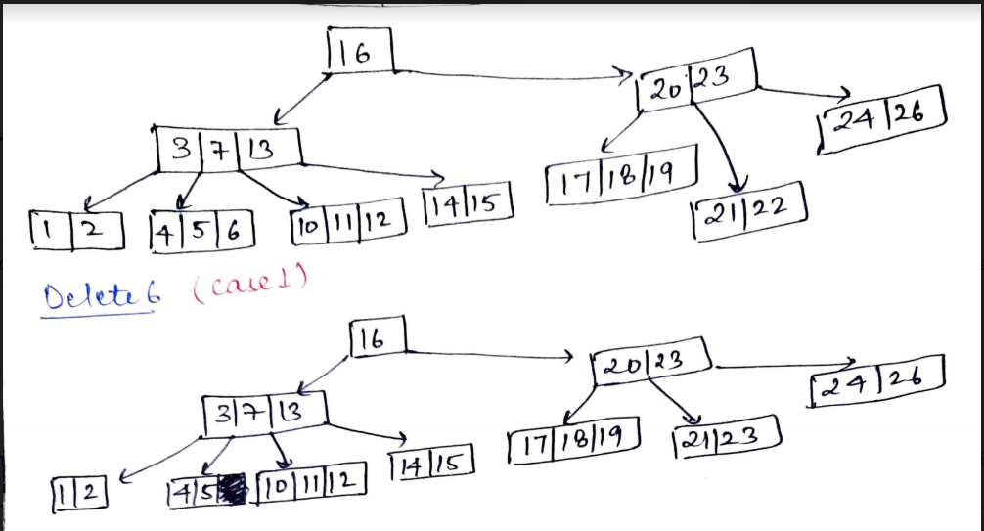
Deleting an element in a b tree..
There are three possible case for deletion in b tree.
Let k be the key to be deleted, x the node containing the key. Then the cases are:
Case-1: If the key is already in a leaf node, and removing it doesn’t cause that leaf node to have too few keys, then simply remove the key to be deleted. key k is in node x and x is a leaf, simply delete k from x.

Slide 10
Case-II
If key k is in node x and x is an internal node, there are three cases to consider:
Case-II-a
If the child y that precedes k in node x has at least t keys (more than the minimum), then find the predecessor key k' in the subtree rooted at y. Recursively delete k' and replace k with k' in x.
Case-II-b
Symmetrically, if the child z that follows k in node x has at least t keys, find the successor k' and delete and replace as before. Note that finding k' and deleting it can be performed in a single downward pass.
Case-II-c
Otherwise, if both y and z have only t−1 (minimum number) keys, merge k and all of z into y, so that both k and the pointer to z are removed from x. y now contains 2t − 1 keys, and subsequently k is deleted.

Slide 11
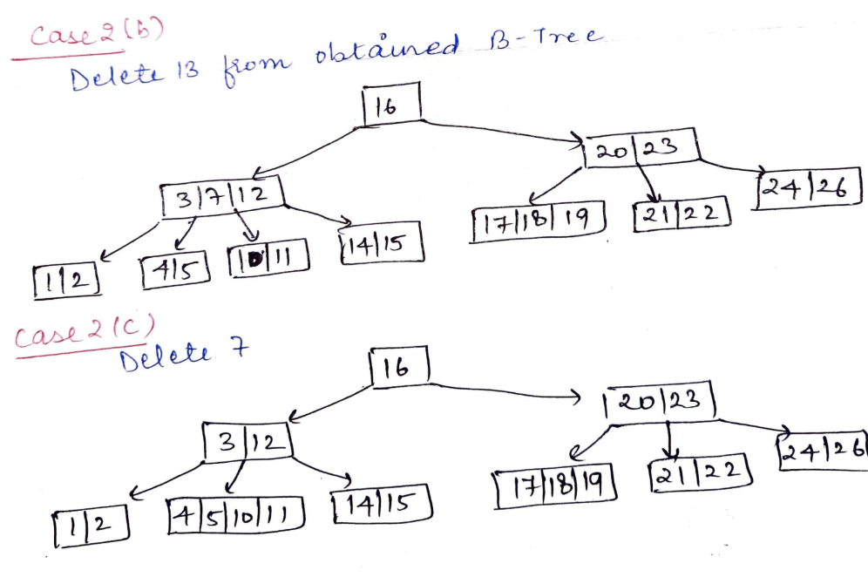

Slide 12
Case-III
If key k is not present in an internal node x, determine the root of the appropriate subtree that must contain k. If the root has only t − 1 keys, execute either of the following two cases to ensure that we descend to a node containing at least t keys. Finally, recurse to the appropriate child of x.
Case-III-a
If the root has only t−1 keys but has a sibling with t keys, give the root an extra key by moving a key from x to the root, moving a key from the roots immediate left or right sibling up into x, and moving the appropriate child from the sibling to x.
Case-III-b
If the root and all of its siblings have t−1 keys, merge the root with one sibling. This involves moving a key down from x into the new merged node to become the median key for that node.

Slide 13
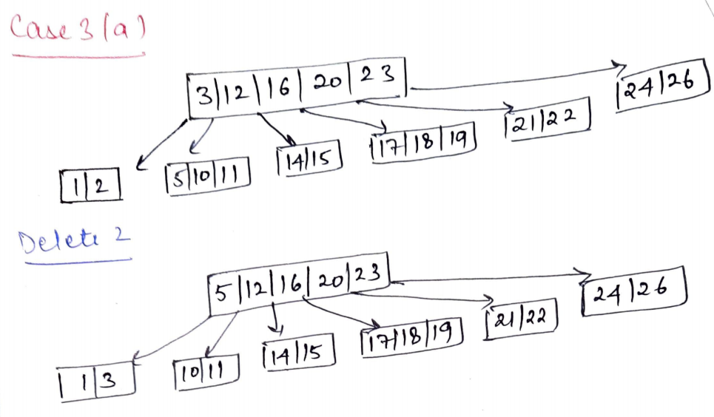
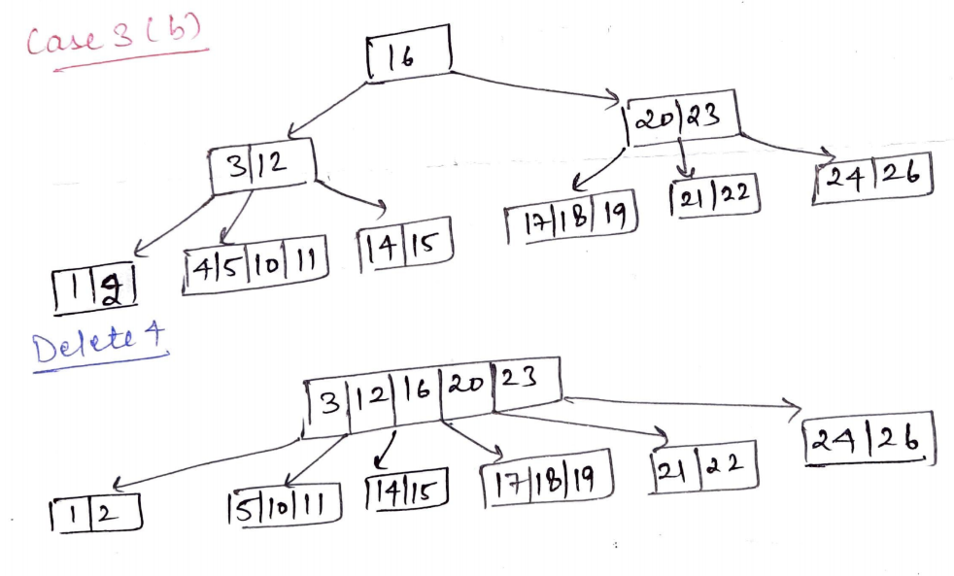

Slide 14
THANK you

